Slide 1





Your Trusted Partner for Industrial
Complete Cleaning Solutions
Rich Professional
Experience
Excellent Expert
Consulting
Timely Execution of
Commitements
Excellent Customer
Relationship & Support

Slide 2

WHO WE ARE
About SUVID Solutions
780+
SUVID Solutions Private Limited
45
At SUVID, we are dedicated to transforming the way businesses approach cleanliness. As a leading supplier of industrial and commercial cleaning equipment, we deliver comprehensive solutions that elevate the standards of commercial spaces.
Our commitment to excellence, innovation, and sustainability sets us apart in the industry.
Total Projects
Expert Professionals
350+
27
Turn Key Projects
Award Winnings

Slide 3
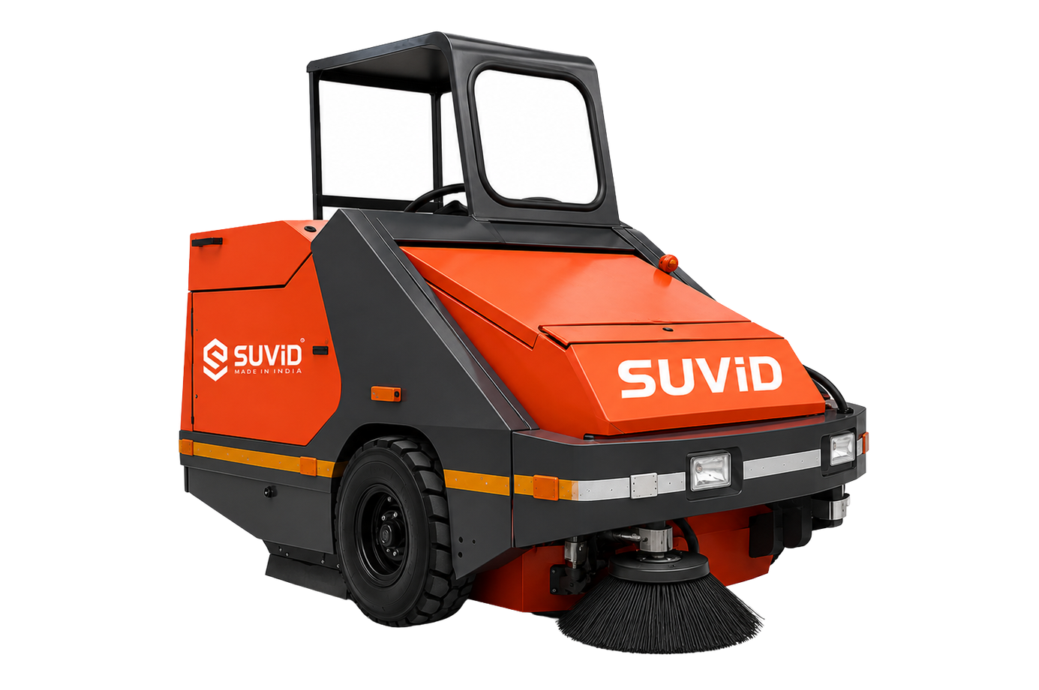
INTRODUCTION
SWEEP1650E
High Performance Ride-on Electric Sweeper
SWEEP1650E
  Top-tier electric ride-on sweeper by SUVID
  Powered by (Li-ion)76.8V / 300Ah long-lasting battery system
  Sweeping capacity of up to 18,150 m²/hr @11kmph
  620-litre integrated dust with High Dump Facilities Upto 1.56m
  1650 mm sweeping width for maximum coverage
  High vacuum power – 20 mbar blower for dust removal
  Premium Hydraulic pump for consistent performance
  Zero emissions – suitable for Both Indoor & Outdoor Applications
  Overhead Guard cabin for operator comfort
  Excellent for all type of Roads & Surfaces
SWEEP1650E
Electric Ride-On Sweeper

Slide 4
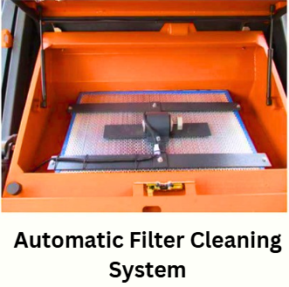
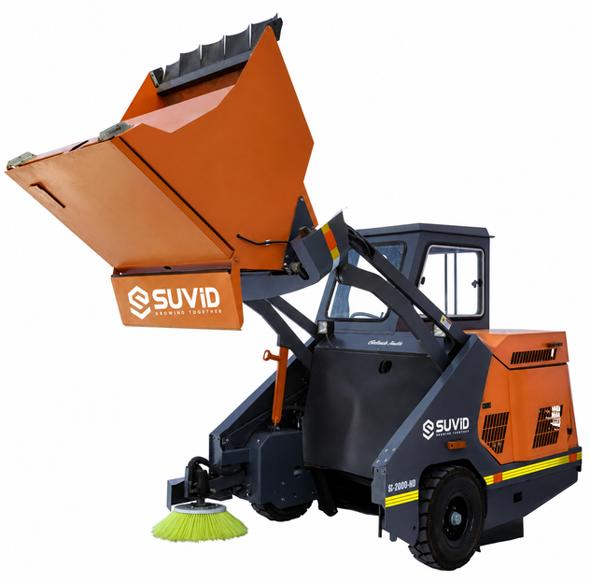
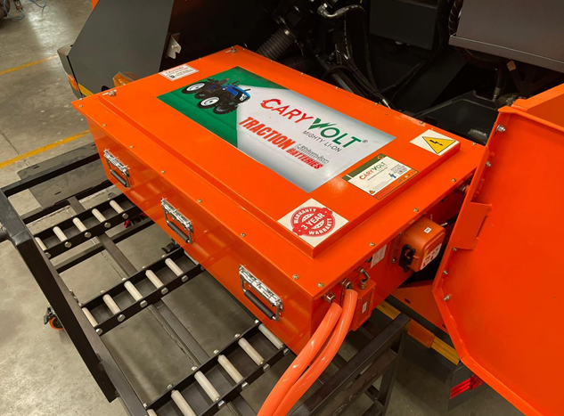
SALIENT FEATURES
SWEEP1650E
76.8V / 400Ah Battery
Automatic Dust Filter Cleaning
Hydraulic High Dump Hopper
Battery Trolley Exchange System
Advanced automatic cleaning system keeps the dust filter clean, ensuring consistent suction and reduced maintenance
620L hydraulic hopper delivers quick unloading and improved operational efficiency
Ergonomic battery trolley enables fast, safe, and hassle-free battery replacement, minimizing downtime and maximizing machine availability
1650mm Sweeping Width | 20m bar Suction Power | 18,150 m²/hr @ 11 kmph| Filter Area 10.8m² |Dump Height 1560mm

Slide 5
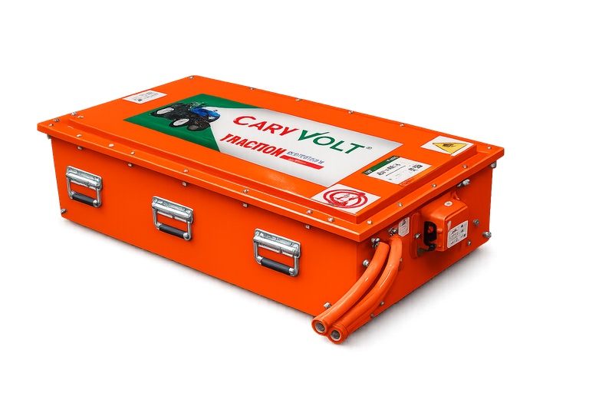
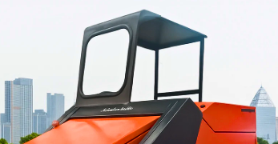
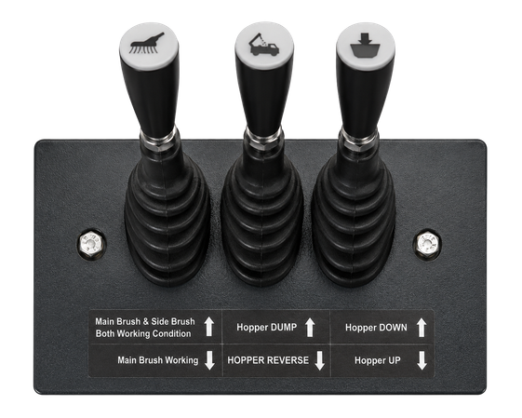
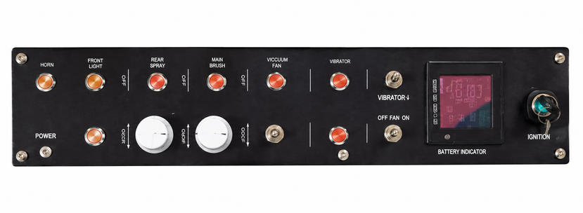
SALIENT FEATURES
SWEEP1650E
76.8V / 400Ah Battery
73.6V / 300Ah Li-ion Battery
Overhead Guard & Safety
Operator Control Panel
Robust overhead guard with safety lighting, rear-view mirror, and warning horn ensures enhanced operator safety and visibility
Ergonomic control panel ensures easy operation, enhanced comfort, and improved productivity
High-efficiency 73.6V / 300Ah Li-ion battery with 22.08 kWh capacity and an 84V / 35A smart charger for extended runtime and fast charging
Height Upto Cabin 2010mm | Overhead Guard | Gradability 18% | 1820 kg Machine Weight | Hydraulic Operations

Slide 6
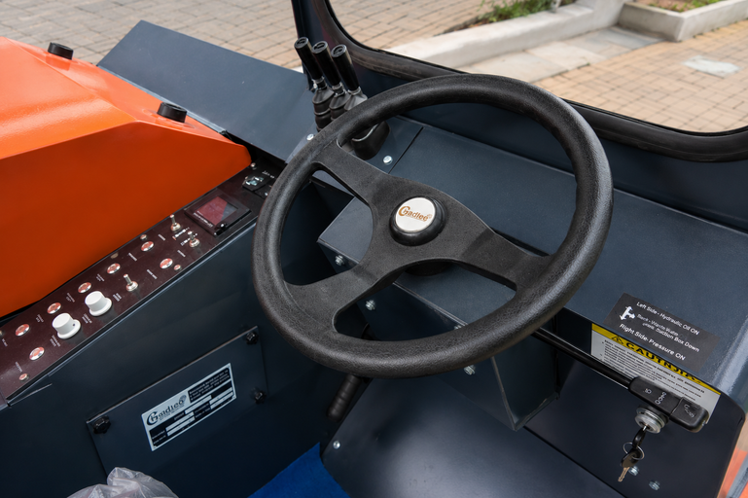
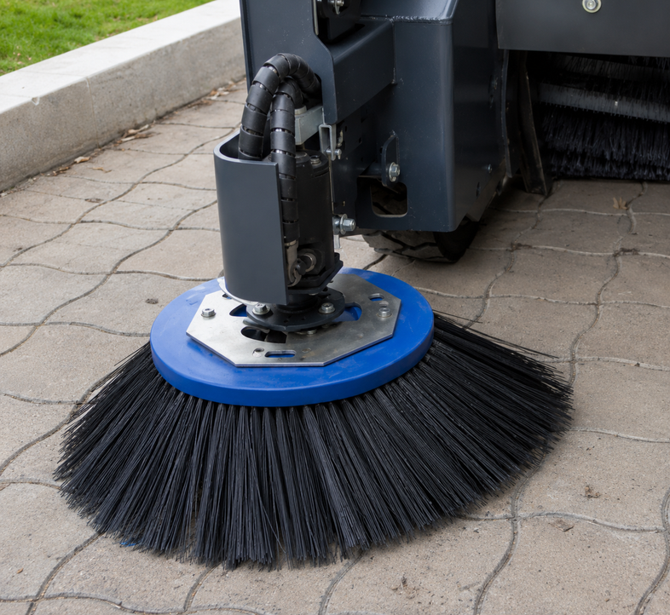
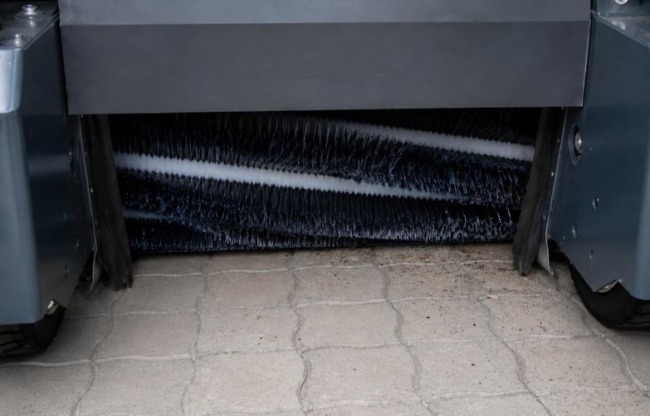
SALIENT FEATURES
SWEEP1650E
76.8V / 400Ah Battery
Ergonomic Controls
Precision Edge Cleaning
Powerful Main Brush System
Electrically actuated side brush ensures effortless up/down movement for improved operational convenience
Actuator-based lifting system provides precise main brush height adjustment for efficient cleaning performance
Optimized control system delivers comfortable handling, easy operation, and greater efficiency.
Width Without Side Broom 1505mm | Side Broom Diameter 660mm | Gradability 18% | 1820 kg Machine Weight | Main Broom Length 1220mm

Slide 7




ADVANTAGES
Why to choose SWEEP1650E?
Large Area Performance
Best in Class
🤖
Covers up to 18,150 m²/hr – equivalent to 25 manual workers, ensuring fast large-scale coverage.
Only 1 operator needed vs. 15–20 manual workers. Reduces labor dependency while boosting output.
🔋
Long Battery Life
All-Weather Performance
76.8V / 400Ah system with quick charging ensures uninterrupted operation across full working shifts.
Operatable both Wet & Dry in All Weather Condition.
🏭
Ideal for Large Campuses
🛡️
Durable & Reliable
Designed for IT parks, industries, airports, warehouses & logistics hubs with heavy-duty hydraulic system.
Premium hydraulic pump and heavy-duty construction ensure long machine life with minimal downtime.
Ergonomic & Sturdy Design
💰
Low Running Costs
Minimal maintenance, no fuel costs – just plug & charge. Dramatically reduces operational expenditure.
Excellent Manufacturing Design to ensure Longitivity & Durability

Slide 8
BENEFITS
What You Gain with the SWEEP1650E?
🌿
Eco-Friendly
🔇
Noise-Free Operation
💨
Dust-Free Sweeping
Zero emissions operation. No fuel, no exhaust – a truly green machine for sustainable campuses.
Ultra-quiet electric drive ensures no noise pollution – perfect for hospitals, schools & offices.
20m bar vacuum blower captures fine dust – no secondary pollution, just clean air.
⏱️
Time Efficient
💸
Cost Effective
♻️
Sustainable Future
18,150 m²/hr @11kmph capacity completes large jobs in a fraction of the time of manual cleaning.
Low operation costs vs other Modes. Minimal maintenance with reduced Overheads in Long term goals and reduced Carbon foot prints
Battery-powered operation aligns with corporate ESG goals and green building certifications.

Slide 9












A COMPLETE
CLEANING SOLUTION
FOR MORE DETAILS
+91 98940 87400 | +91 98946 83031
exports@suvidsolutions.com
www.suvidsolutions.com
SUVID Solutions Private Limited, 136, Sesi Avenue, Nehru Nagar West, Coimbatore - 641014, INDIA

